Slide 1

NEPAD Nutrition and Food Systems Strategic Programme
Towards Coordinated and Accelerated Action for the Eradication of Hunger and Malnutrition in Africa
NEPAD-EAC-IGAD KM Training Workshop,
11 September 2018
Kefilwe Moalosi – Senior Nutrition Officer

Slide 2
Some BIG Challenges!! - opportunities
Preaching to the converted
Not engaging all the required sectors adequately
Poor dissemination of tools
Poor messaging
Poor/low capacities – we need boots on the ground
Poor/low investments
Questionable advocacy and prioritization

Slide 3
What?
So what?
Now what?

Slide 4
The NEPAD Programme identifies four programme components
Component 1: Creating an Enabling Environment
Component 2: Nutrition-Sensitive Programming
Component 3: Embedding Flagships
Component 4: Underlying Cross-Cutting Considerations

Slide 5
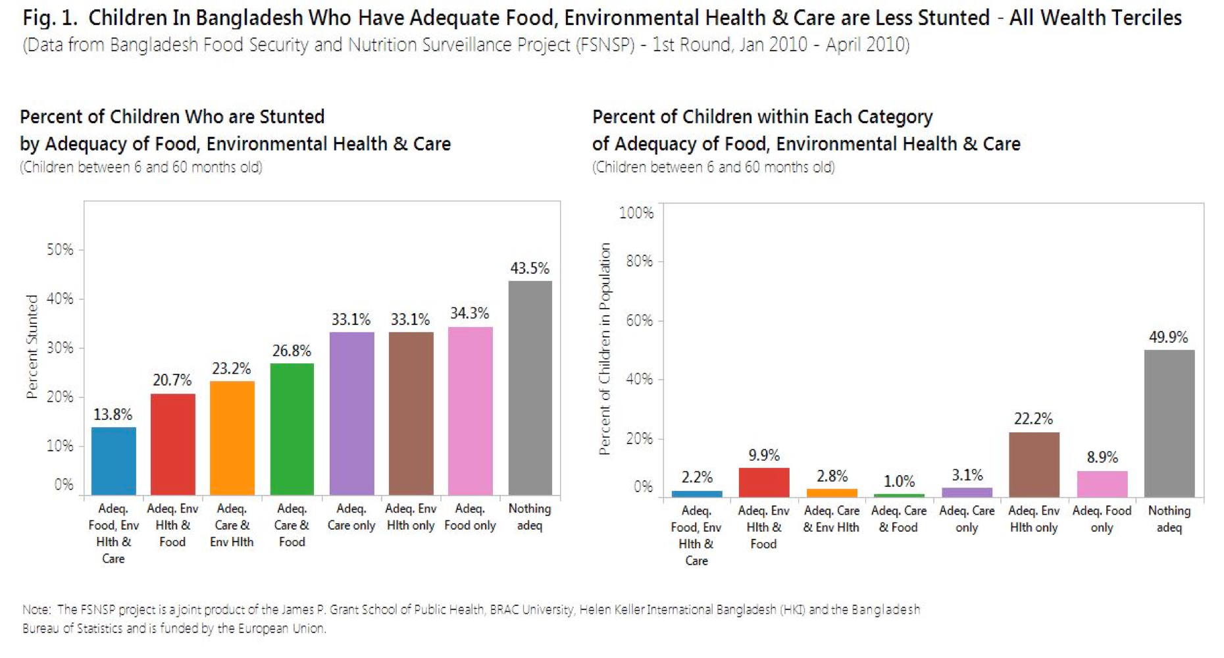
Notes:
See accompanying paper

Slide 6
Policy coherence
Millennium Development Goals, 2000
Zambia Vision 2030, GRZ 2006
Zambia Poverty Reduction Strategy Paper, IMF 2007
Zambia Sixth National Development Plan, GRZ 2011
Nutrition | Agriculture | Health | Education | Social protection | Water and sanitation
SUN Framework for Action 2010 | CAADP agreement | World Health Assembly agreement
National Food and Nutrition Policy 2006 | National Agriculture Policy 2004-15 | National Health Policy 1992 | National School Health and Nutrition Policy 2006
National Food and Nutrition Strategic Plan 2011-15 | MAL Strategic Plan 2013-16 (“Budget Strategy”) | National Health Strategic Plan 2011-16 |  | Social Protection Framework 2013 | WASH Framework 2006
1000 Most Critical Days Program 2013-15 | Agriculture Sector Implementation Plan | Micronutrient Policy 2005-2011 | School Health and Nutrition Program Guidelines 2008 |  | National Rural / Urban Water & Sanitation Supply Programmes
 | National Agriculture Investment Plan 2014
Multisectoral District Plan (Mumbwa) | Agriculture Ministry Workplan (Mumbwa) | MCDMCH-DOH Workplan (Mumbwa) | Education Ministry Workplan (Mumbwa) | MCDMCH-DCW/DSP Workplan (Mumbwa) | Local Gov Ministry Workplan (Mumbwa)
Notes:
Each column represents a different policy domain such as nutrition, health, agriculture and education. Each begins at a higher level reflecting a broader policy followed by a strategy that may be “translated” into sub-regional plans.
Based on our analysis, it stands to reason that there has been important coherence through each of the major domains pertaining to nutrition. This, in turn, has converged into the multi-sectoral district plans that give substance to the MCDP.
There is clearly deliberate and methodical action across different domains of policy as sectors come under review and their strategies revised.
This process is far from finished, but the language of nutrition is being incorporated into other sectoral policy.

Slide 7
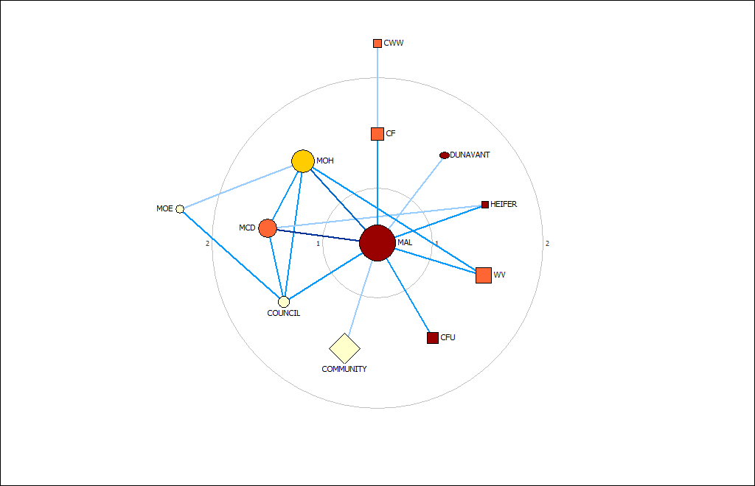
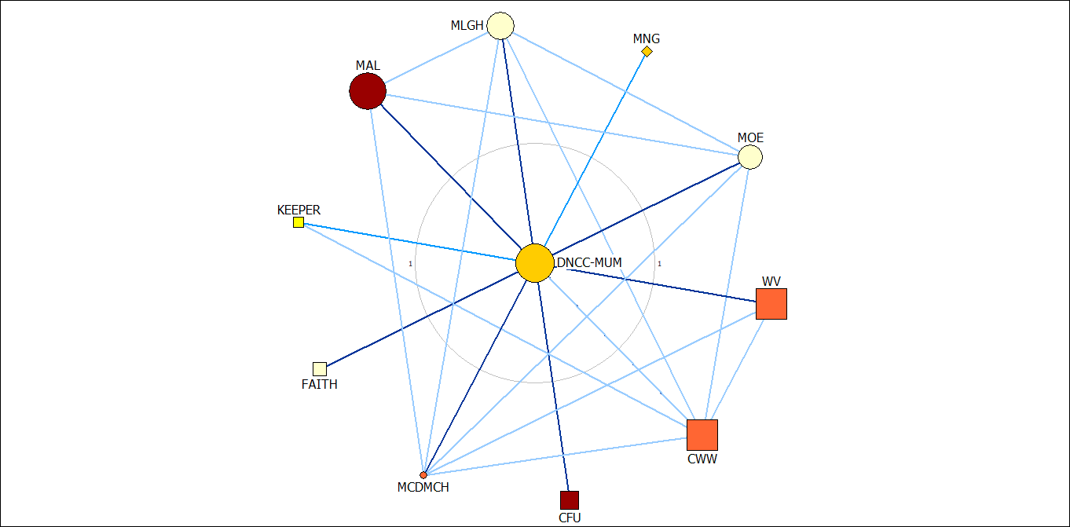
Coordination Mechanisms
2011
2015
Notes:
the diagrams show the ‘collaboration’ links from the local NetMaps in Mumbwa in 2011 and 2015.
The figures have captured visually the changes we know have happened-
in 2011 MAL and to some extent MOH and MCD were considered the hubs for nutrition, but interaction was not consistent among the ministries and other partners- and in fact from the interviews we did at the time, we know that people were not really even sure what the other sectors were doing or what it meant to be ‘working for nutrition’.
Fast forward to 2015 and we have a map shape that is considered a much stronger network, with the DNCC now as the hub, but also consistent interactions between the network members even outside of the DNCC- and the interviews reveal a very strong understanding of what it means for each sector to be involved in nutrition.

Slide 8
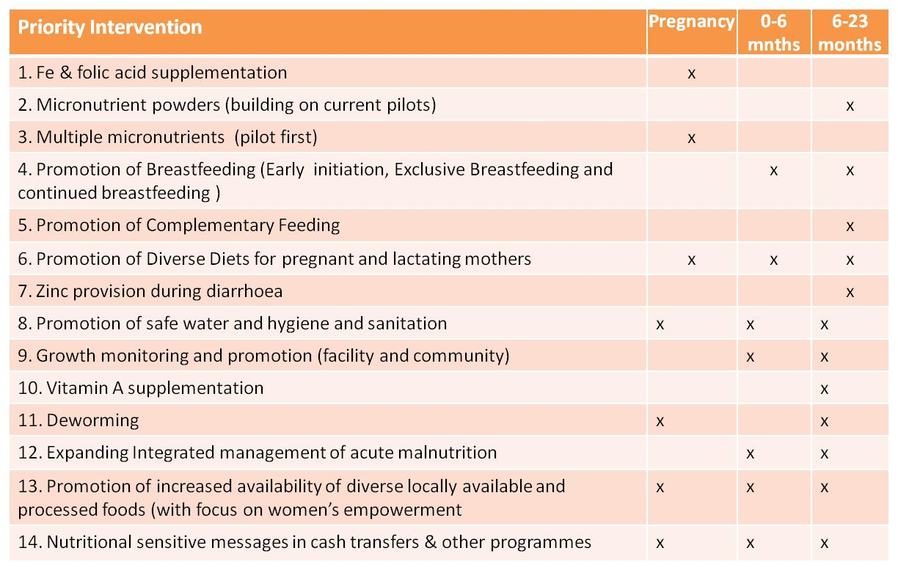

Slide 9
Flagship Programmes for Nutrition and Food Security
  Maternal and Child Nutrition
  Home Grown School Feeding
  Addressing Micronutrient Deficiencies through Food Fortification, Biofortification and Supplementation
  Dietary Diversification – dietary guidelines, food baskets and indigenous crops
  Food Safety and Quality Management
  Non Communicable Diseases
  Communicable Diseases

Slide 10
Flagship Programmes for Nutrition and Food Security
  Capacity Development
  Policy and Advocacy
    Agenda 2063, Malabo, ARNS, IFNA, SUN, ICN2, SDGs, Cost of Hunger in Africa, Pan African Parliamentary Alliance for Food and Nutrition Security, African Leaders for Nutrition, the RECs Food and Nutrition strategies, and others.

Slide 11
Cross Cutting Issues
Promote technical and nutrition leadership - capacity development
Initiate and implement a combined knowledge management platform (Surveillance)
Conduct and promote regional tracking of the nutrition situation
Convene consultative and discussion fora
Support regional and continental initiatives

Slide 12
Role of NEPAD
Convening
Policy alignment
Advocacy
Surveillance
Galvanising grassroots engagement
Accountability and reporting
Capacity strengthening

Slide 13
Delivery Modality
“Five Country – Five Region” Initialization:
  Botswana
  Burundi
  Chad
  Egypt
  Equatorial Guinea
Investment Meeting with key partners/ funders

Slide 14


